Slide 1
FARINA RESTORATION GROUP INC
THIS BUILDING COMMENCED IN 2017 AND TOOK THREE YEARS IN THE MAKING BY OUR WONDERFUL GROUP OF VOLUNTEERS.
PRACTICAL COMPLETION WAS ACHIEVED October 2019.

Slide 2
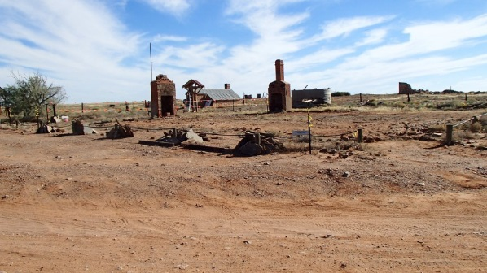
Prior to 1980 Pattersons looked like this. Illustration by Kevin Waters
After the fire the site remained bare for some 35 years.

Slide 3
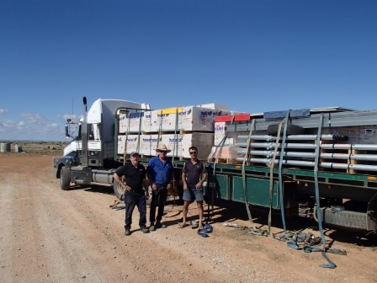
Our first delivery of many.

Slide 4
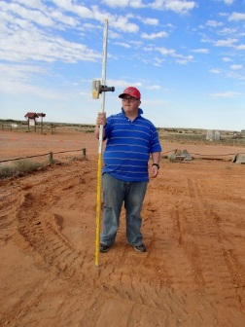
Getting the levels right.

Slide 5
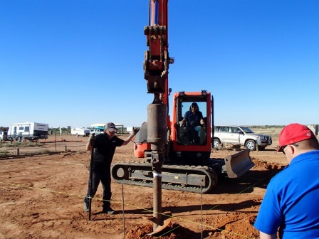
The machinery to dig holes.

Slide 6
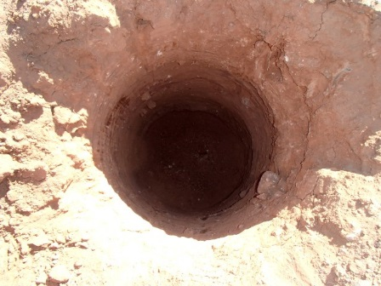
Bored piers to support the building.

Slide 7
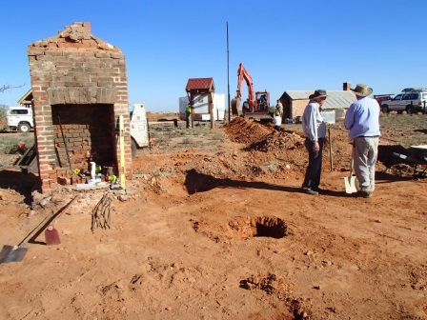
The many piers and earthworks continuing.

Slide 8
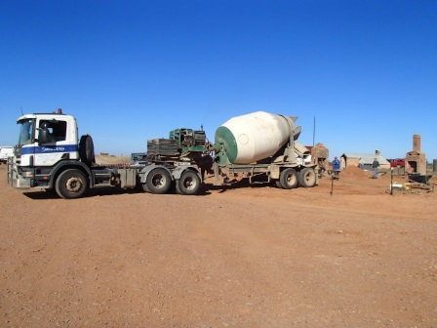
Concrete delivery ex Hawker.

Slide 9
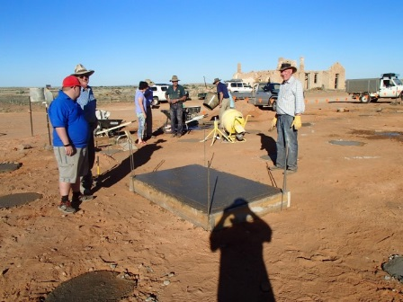
The last pour including the chimney base.

Slide 10
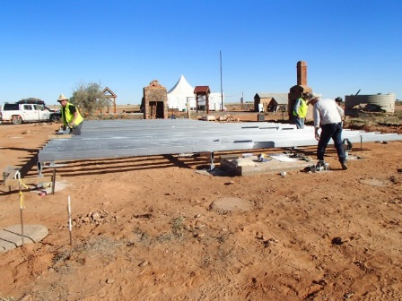
Stage 1 Steel flooring system.

Slide 11
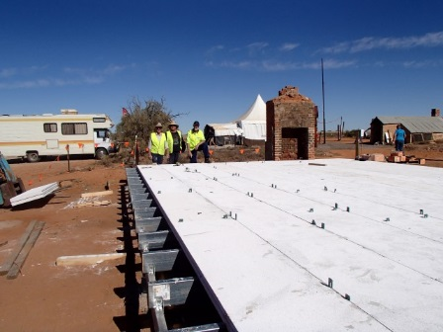
HEBEL sub floor panels installed.

Slide 12
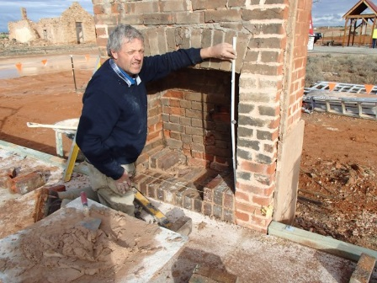
Master at work.

Slide 13
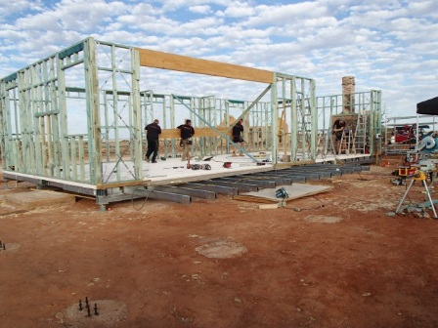
Wall frames up.

Slide 14
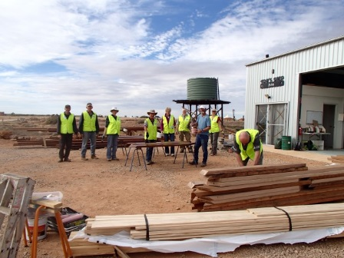
Roof truss preparation team.

Slide 15
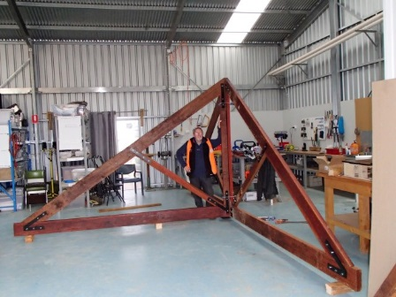
Roof truss re-assembled.

Slide 16
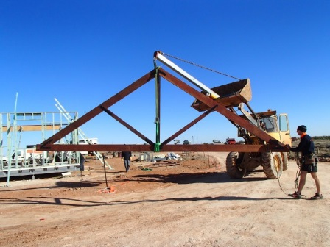
Erection of roof trusses.

Slide 17
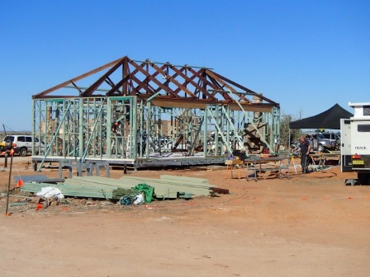
Roof trusses installed stage 1.

Slide 18
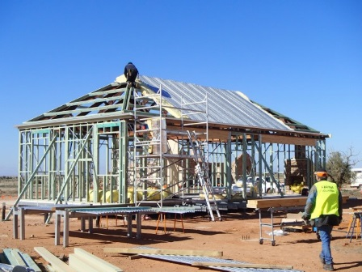
Roof sheeting underway.

Slide 19
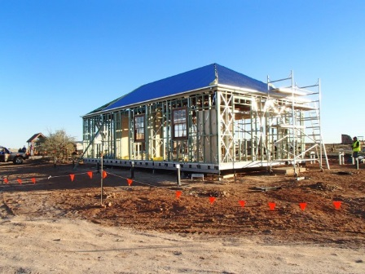
Roof and frames erected.

Slide 20
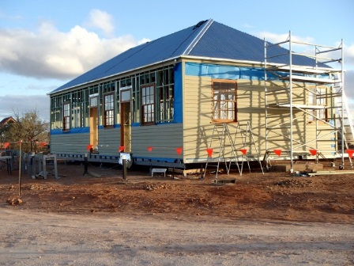
Wall cladding underway.

Slide 21
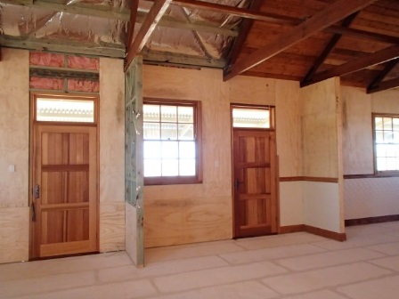
Stabilizing sheet ply and windows, doors installed.

Slide 22
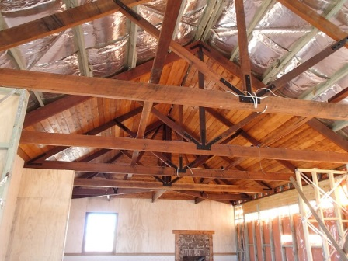
Underside of roof blanket and lining started.

Slide 23
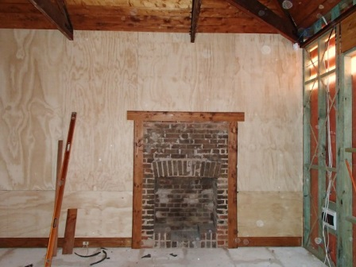
Building in around “Original” fireplace.

Slide 24
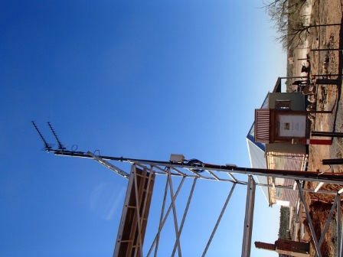
Our 3G antenna.

Slide 25
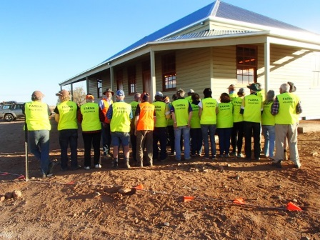
Some of our Stage 1 volunteers.

Slide 26
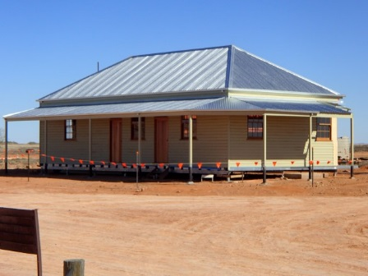
Stage 1 complete 2017.

Slide 27
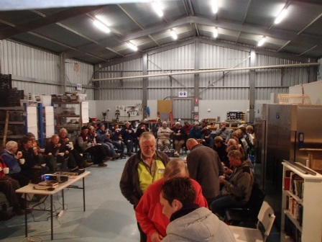
Stage 1 magnificent team.

Slide 28
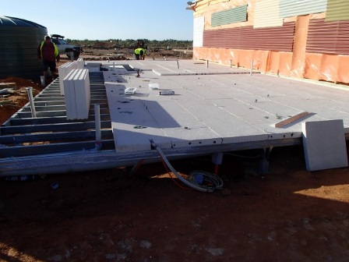
Stage 2 Floor system 2018.

Slide 29
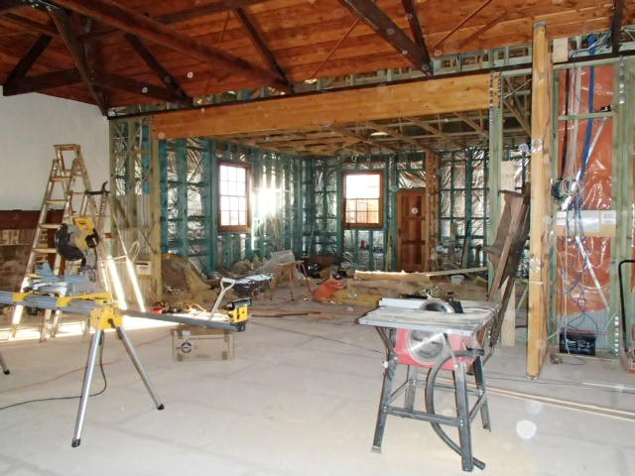
Stages 1 & 2 Internal wall frames.

Slide 30
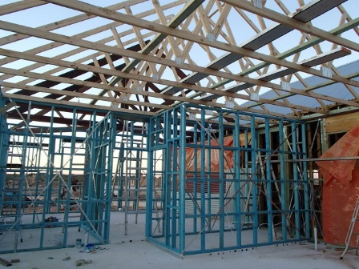
Stage 2 Kitchen area.

Slide 31
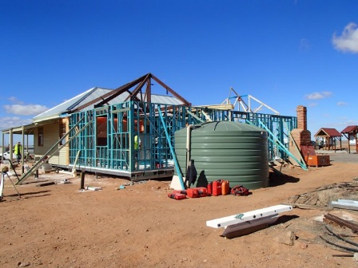
Stage 2 roof area and water storage.

Slide 32
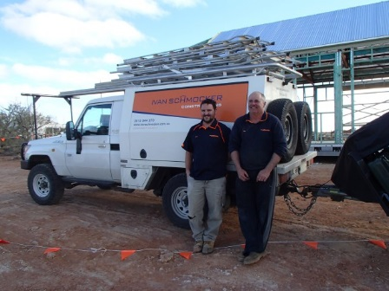
One of our fantastic donor volunteer companies.

Slide 33
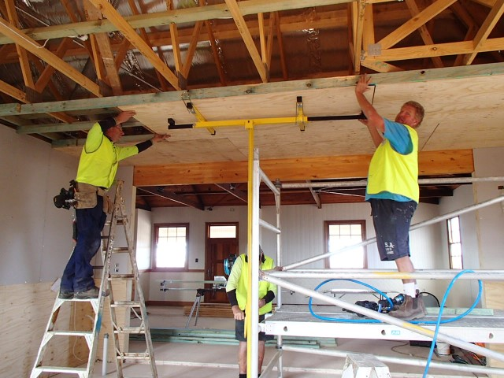
Ply sub support for ceiling to kitchen area.

Slide 34
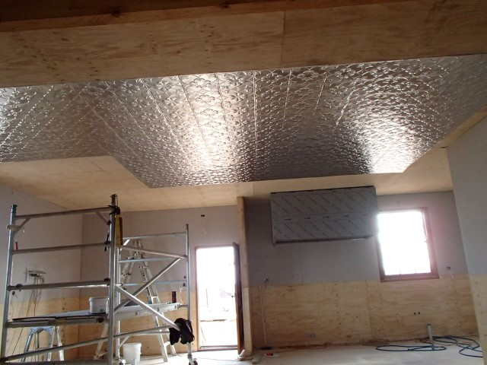
Pressed metal ceiling underway.

Slide 35
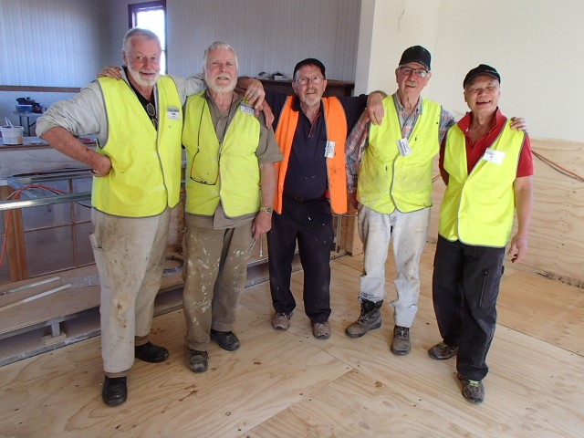
The sub floor ply installation crew.

Slide 36
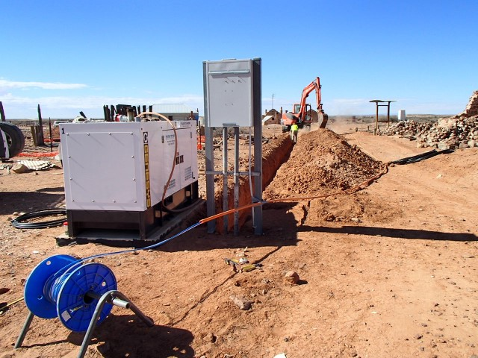
Electrical sub main installation.

Slide 37
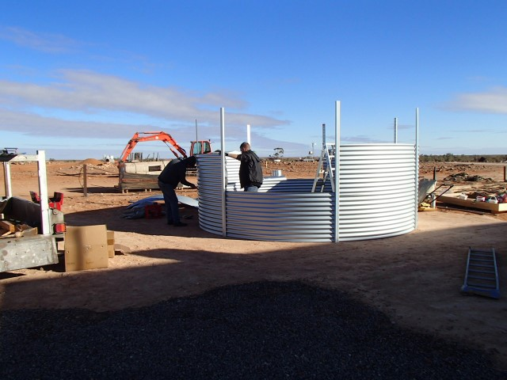
One of our water storage tanks.

Slide 38
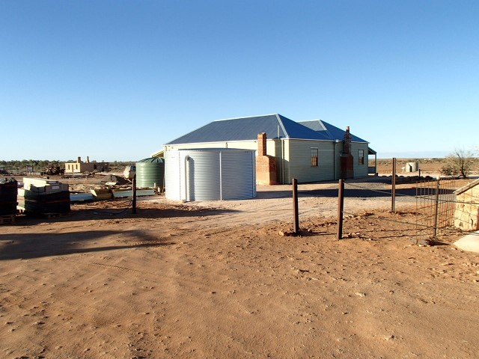
Tank complete.

Slide 39
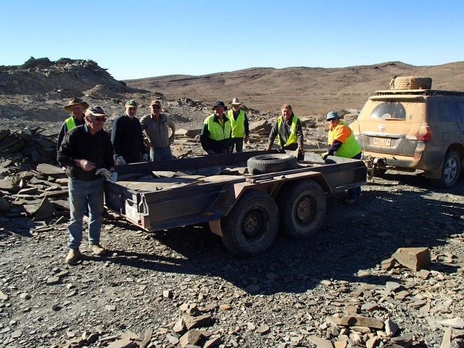
A day in the “Slate Quarry”.

Slide 40
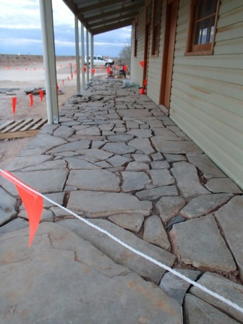
Slate laying direct from the quarry.

Slide 41
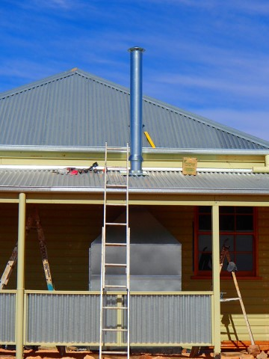
The Galvanized chimney installation.

Slide 42
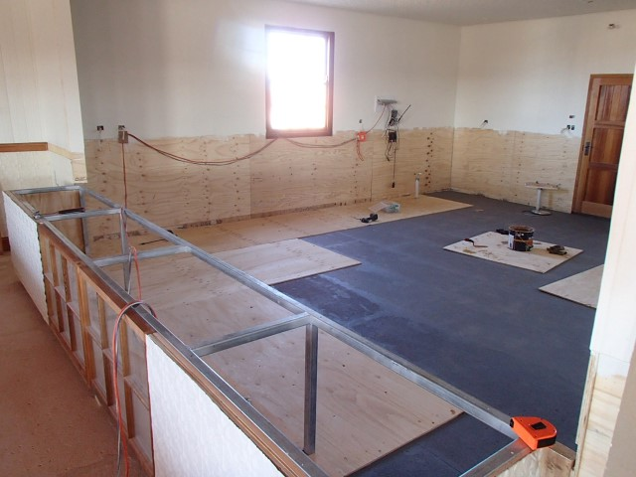
Kitchen area Vinyl sub floor.

Slide 43
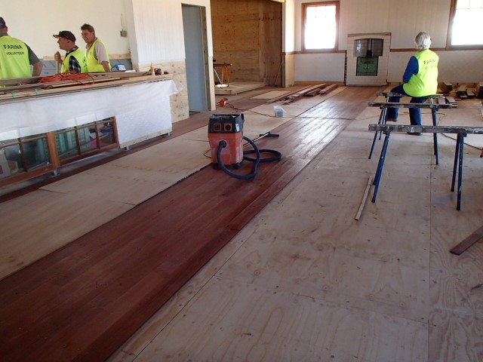
Re-cycled “Spotted gum” flooring underway.

Slide 44
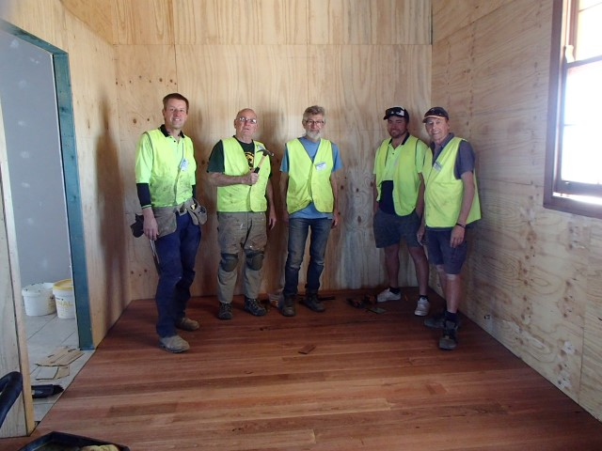
Team completion of the “Spotted gum” floor.

Slide 45
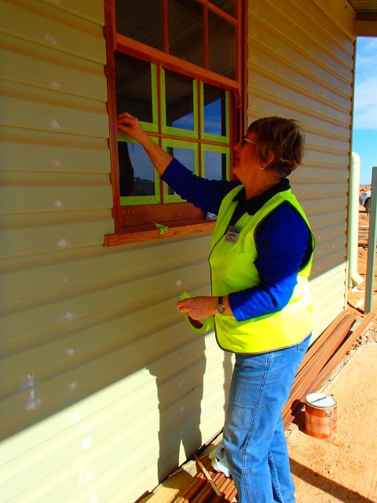
Oiling windows and paint preparation.

Slide 46
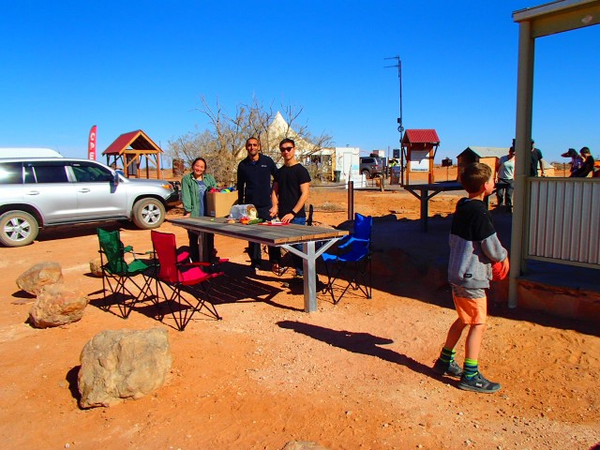
Our very first family to use the tables installed the day before.

Slide 47
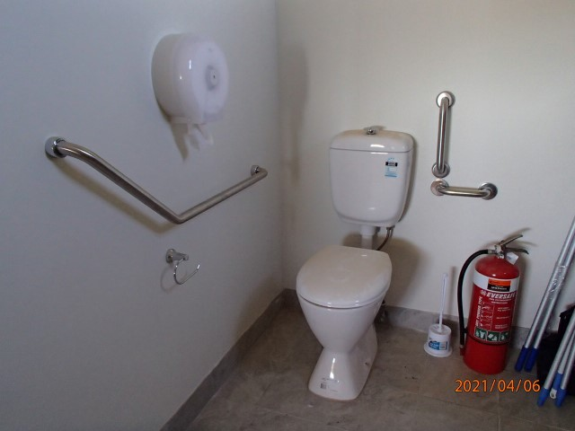
Bathroom.

Slide 48
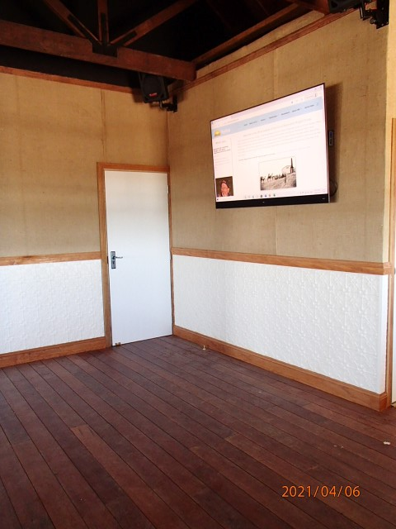
Internal fitout complete.

Slide 49
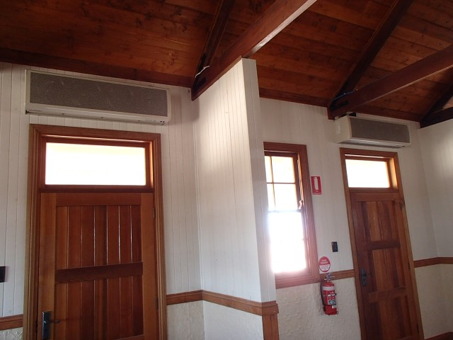
“Air Curtains” above doors.

Slide 50
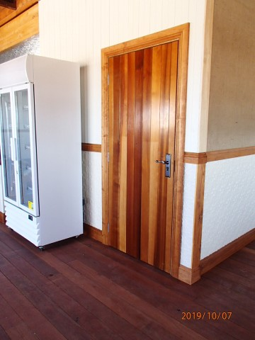
Media room.

Slide 51
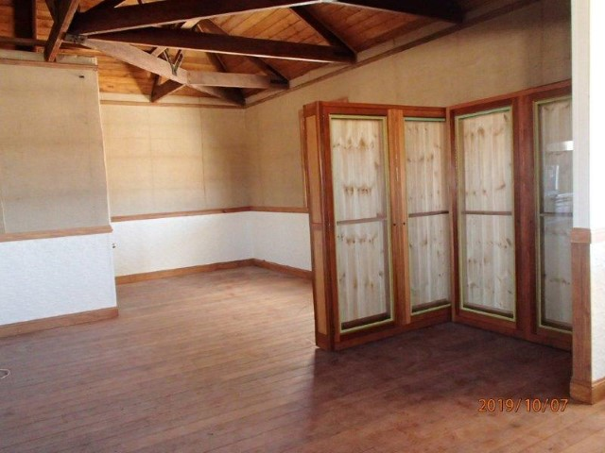
Merchandising area.

Slide 52

Café counter.

Slide 53

Museum area.

Slide 54

Outer kitchen area.

Slide 55

Western elevation.

Slide 56

Easterly elevation.

Slide 57

North Easterly elevation.

Slide 58

The kitchen and all the “Bits”.

Slide 59

Café seating.

Slide 60

Set up for larger groups.

Slide 61

Stage 2 completion team.

Slide 62
The FARINA RESTORATION GROUP would like to acknowledge the support, goodwill and generosity of all of our volunteers and suppliers who participated in building this wonderful community facility.
Needless to say it doesn’t matter how big or small your contribution was, it has all been focused on the completion of the building, which took us three years and many thousands of hours of dedicated commitment by all.
We all had such fun in participating and we hope that this building will go on to support the local Farina Community for many years to come.
Please enjoy.
If you would like to use the building for an event please let us know.

